Slide 1




Uses of Generative AI in the Research Setting
Kenneth Cox and Jennifer Morris
MIT Center for Sustainability Science and Strategy
Nov. 12, 2024

Slide 2
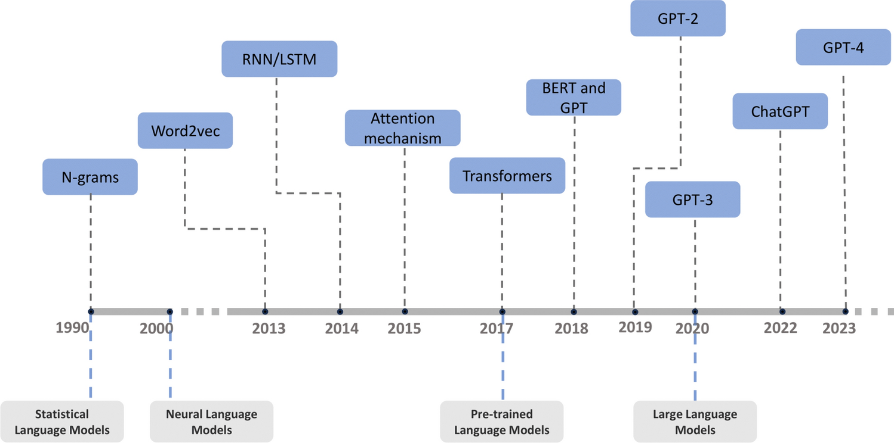
Overview - History
The types of tools we will demonstrate are examples of generative AI, particularly large language models (LLMs)
Original methods for human-machine communication in natural language relied on finding statistical regularities in language, which is the basis of intelligence but does not fully constitute it
Neurons and the brain became the inspiration for a different class of models, artificial neural networks (ANNs), which steadily outperformed prior statistical models in language prediction/generation tasks (Wang et al. 2024)
A breakthrough in 2017 led to an ANN architecture called the transformer, which vastly improved both the accuracy and efficiency of these models (Vaswani et al. 2017)
The transformer architecture underpins all modern large language models

Slide 3
Overview - Popular Models
The most well-known, and most validated, LLM is OpenAI’s generative pre-trained transformer (GPT) series of models (GPT-4 is the most recent)
GPT-4 is usually accessed via its chat feature, ChatGPT
Claude, a LLM developed by Anthropic, has also become popular
Google and Meta have developed their own LLMs (Gemini and Llama), but their performance is comparatively weak

Slide 4
Capabilities
There are four main categories where mainstream LLMs excel:
Problem Solving
(Solutions or direction for a stated problem)
Explanations
(Brief or lengthy)
Coding
(Writing code, debugging, understanding code, documentation, etc)
Writing
(Summarizing, editing, writing)

Slide 5
References
Wang, Zichong, Zhibo Chu, Thang Viet Doan, Shiwen Ni, Min Yang, and Wenbin Zhang. “History, Development, and Principles of Large Language Models: An Introductory Survey.” AI and Ethics, October 14, 2024. https://doi.org/10.1007/s43681-024-00583-7.
Vaswani, Ashish, Noam Shazeer, Niki Parmar, Jakob Uszkoreit, Llion Jones, Aidan N Gomez, Łukasz Kaiser, and Illia Polosukhin. “Attention Is All You Need,” n.d.

